Slide 1
The Complicated Problem of Motivation
By Sabrina Khan

Slide 2
“Once a person is determined to help themselves, there is nothing that can stop them.”
-Nelson Mandela

Slide 3
Competence Motivation

Slide 4
Power Motivation

Slide 5
Attitude Motivation

Slide 6
Achievement Motivation
Competence Motivation
Power Motivation
Attitude Motivation

Slide 7
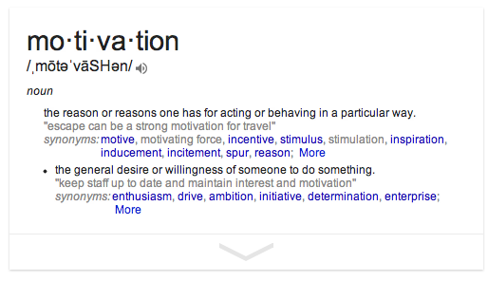
Google’s Definition of Motivation

Slide 8
Abraham Lincoln

Slide 9
The Faults Of Motivation

Slide 10
Pygmalion Theory/Effect

