Slide 1
Ted Talk Presentation
Faiza Khan

Slide 2
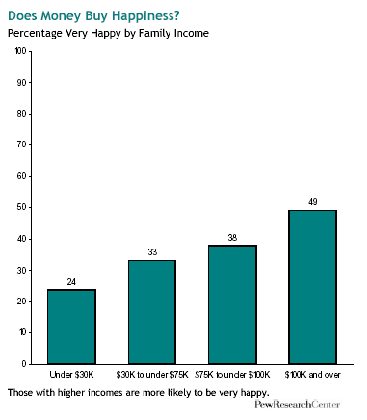
www.economist.com

Slide 3
“‘We've shown in our research that giving money to others actually does make people happier,’... ‘One of the reasons is that it creates social connections…”’ ~Michael Norton
http://hbswk.hbs.edu/item/7337.html

Slide 4
Donating Money Increases Happiness
blogs.scientificamerican.com

Slide 5
“You need a certain amount of dough–$50,000, on average–to be happy. But once you have north of $75,000, you won’t see much of a noticeable difference when it comes to your happiness quotient.”
http://www.forbes.com/sites/learnvest/2013/01/25/money-does-buy-happiness-we-were-shocked-too/

Slide 6
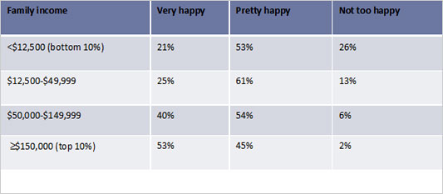
People of different social classes on their happiness
freakonomics.com

Slide 7
Wealthy people also have concerns...
The American Psychological Association mentions that wealthy people usually may not know if a person likes them or their money, which can hurt social connections because they can not trust someone as easily.

Slide 8
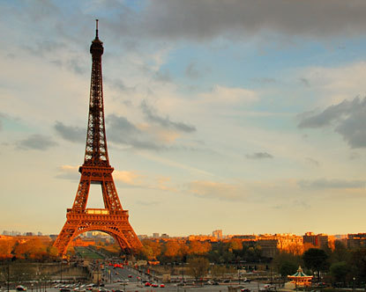
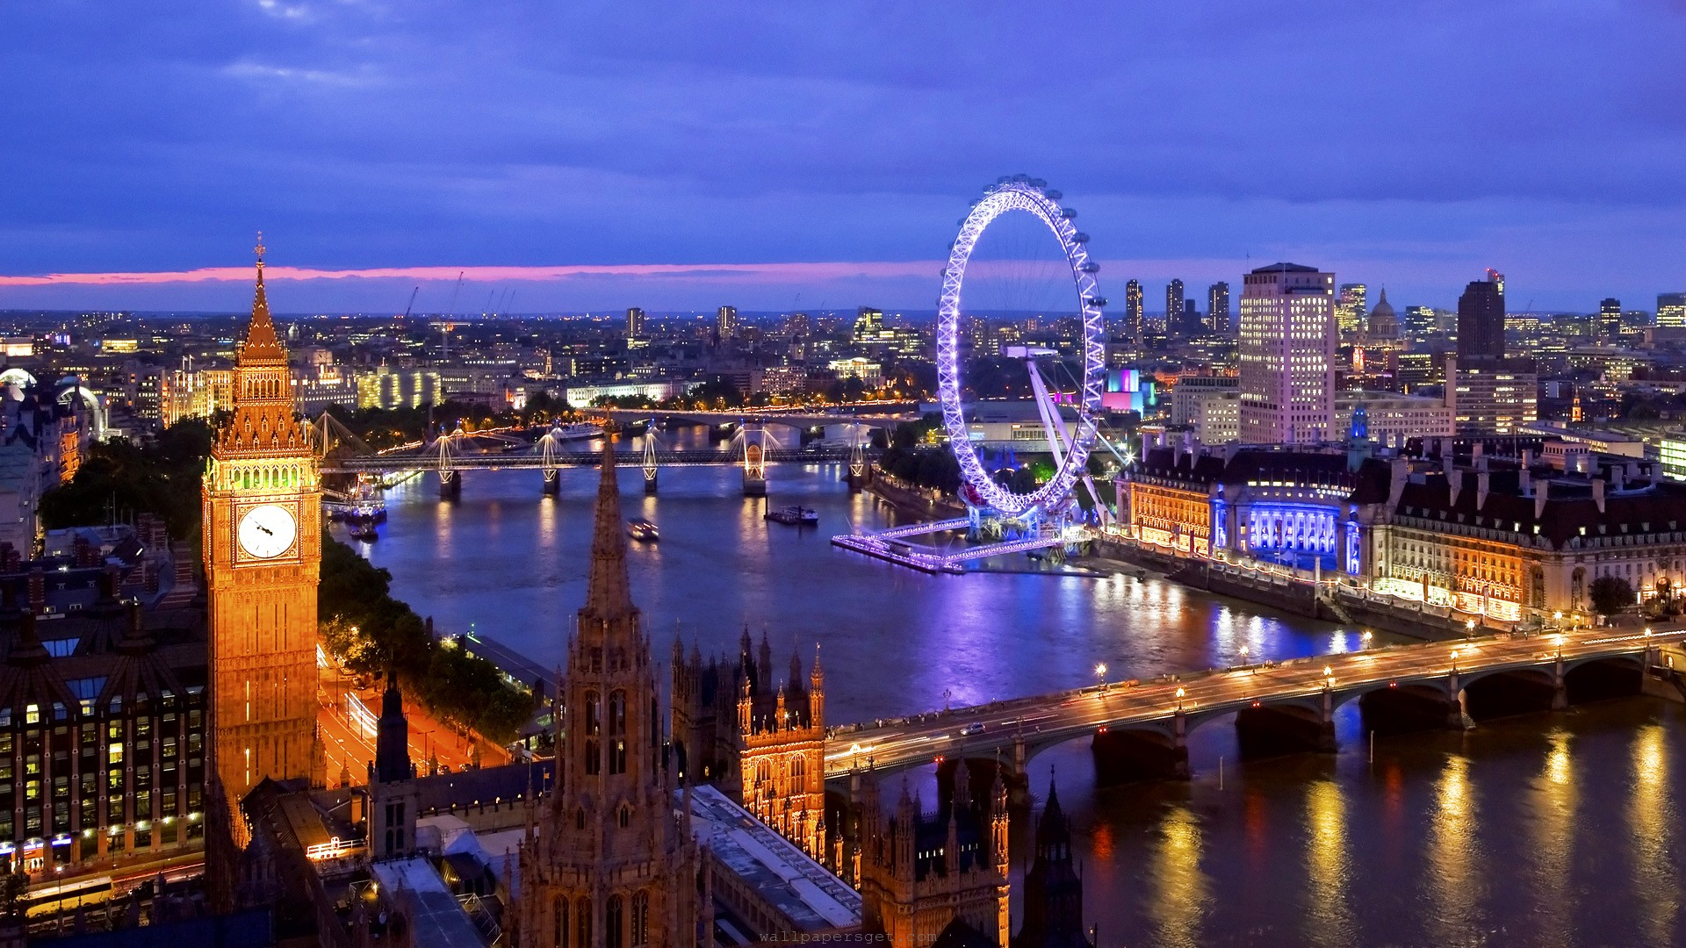
Traveling Buys Happiness
Paris, France
www.destination360.com
London, England
londonhotelvideos.info

Slide 9
Conducting my own research:
Most teenagers would immediately want $100 now than $150 next month. They are more impatient.
Adults are generally more patient and usually think that happiness comes from within, and for being grateful.

Slide 10
Works Cited
http://hbswk.hbs.edu/item/7337.html
http://finance.fortune.cnn.com/2013/05/01/money-happiness/
http://www.nytimes.com/2012/07/08/opinion/sunday/dont-indulge-be-happy.html?pagewanted=all
http://www.forbes.com/sites/learnvest/2013/01/25/money-does-buy-happiness-we-were-shocked-too/
http://www.nytimes.com/2012/07/08/opinion/sunday/dont-indulge-be-happy.html?pagewanted=all
http://www.nytimes.com/2012/07/08/opinion/sunday/dont-indulge-be-happy.html?pagewanted=all
https://www.gsb.stanford.edu/news/headlines/research-can-money-buy-happiness
http://www.huffingtonpost.com/2013/08/22/happiness-giving-social-connection_n_3786993.html
http://articles.latimes.com/2013/may/19/opinion/la-oe-norton-happiness-spending-20130519
http://www.nydailynews.com/life-style/health/money-buy-happiness-article-1.1458890
http://www.pbs.org/thisemotionallife/blogs/can-money-really-buy-happiness
http://abcnews.go.com/Business/concerns-super-rich-wealth-bring-happiness/story?id=13167578
http://greatergood.berkeley.edu/article/item/5_ways_giving_is_good_for_you

