Slide 1
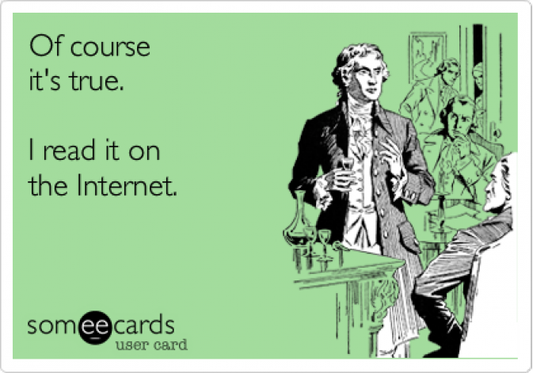
Aim: How can we discern a credible source?
How do you know what to believe and what not believe when it comes to believing information?

Slide 2
Is this credible? Why/Why Not?

Slide 3
Credible Sources
Official government websites (gov)
Institutional sites that represent universities, regulatory agencies, governing bodies, and respected organizations with specific expertise (edu)
Peer-reviewed journals
Reputable news sources (com)
WHAT SHOULD WE AVOID?????

Slide 4
Not so credible…
Blogs
Web forums
Individual or business websites
Materials published by an entity that may have an ulterior motive

Slide 5
Independent Work
Open your Google Doc and have it ready for research!
Create a section for vocabulary as you collect
As you visit your various sources, make sure you are thinking about whether or not they are credible
Use the checklist to guide you

Slide 6
Homework
Continue research
Read for 40 mins.
Visit the library
Please return any borrowed books

